Slide 1
Alpha Chess: What's Before Neural Network?
Construct Out-performed Chinese Chess AI Agents Without Learning

Slide 2
Part 1: Train an agent
Alpha Zero
Monte Carlo Tree Search
Neural Network
Problem we met

Slide 3
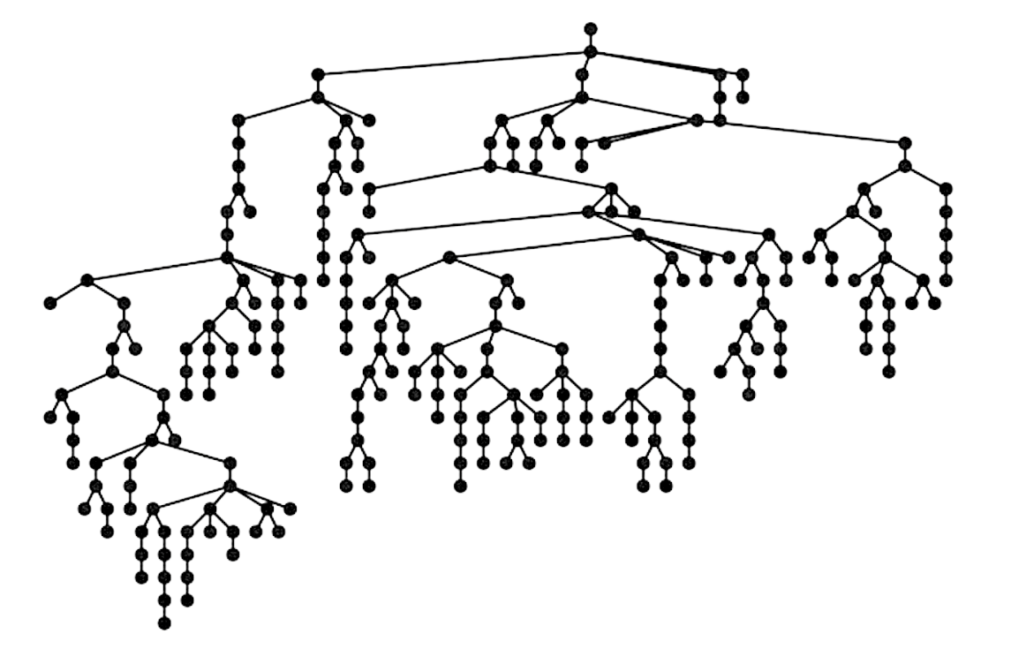
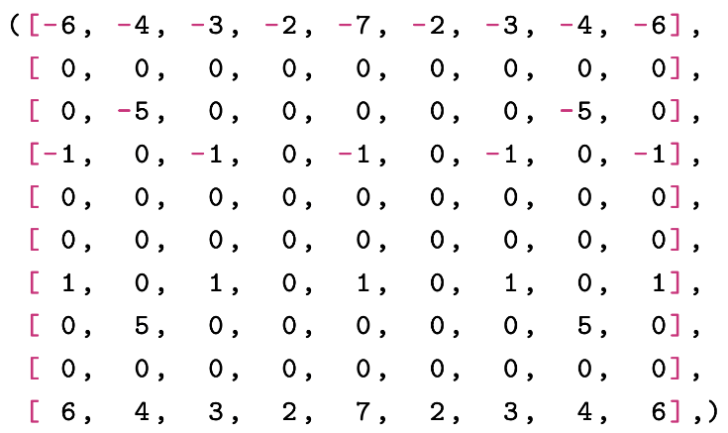
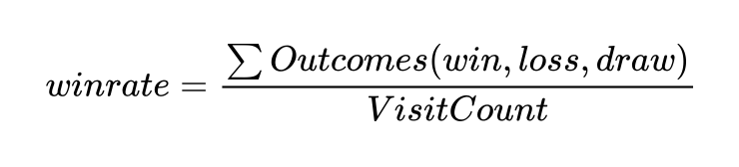
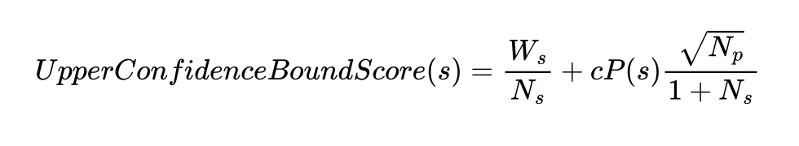
Monte Carlo Tree Search
Represented Board
MCTS

Slide 4
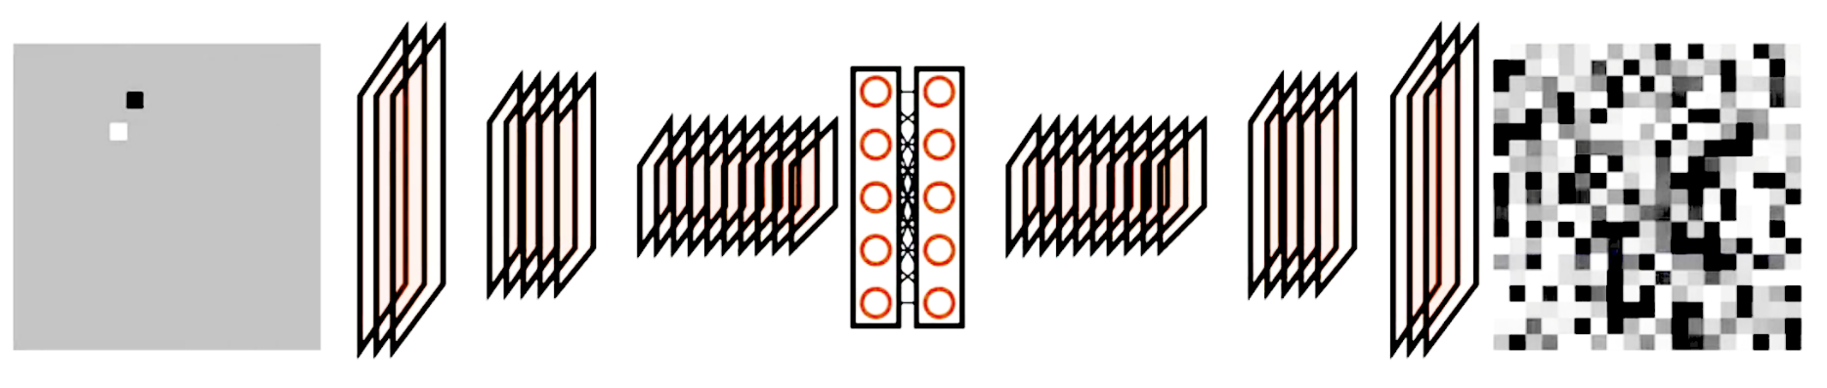
Neural Network
Neural Network Structure
Input: board state
Outputs: 1. A vector representing probability distribution over moves, 2. A value representing the probability of the current player winning.
Goal: maximize the similarity of the vector to the search probabilities, minimize the error between the predicted winner and the actual winner.

Slide 5
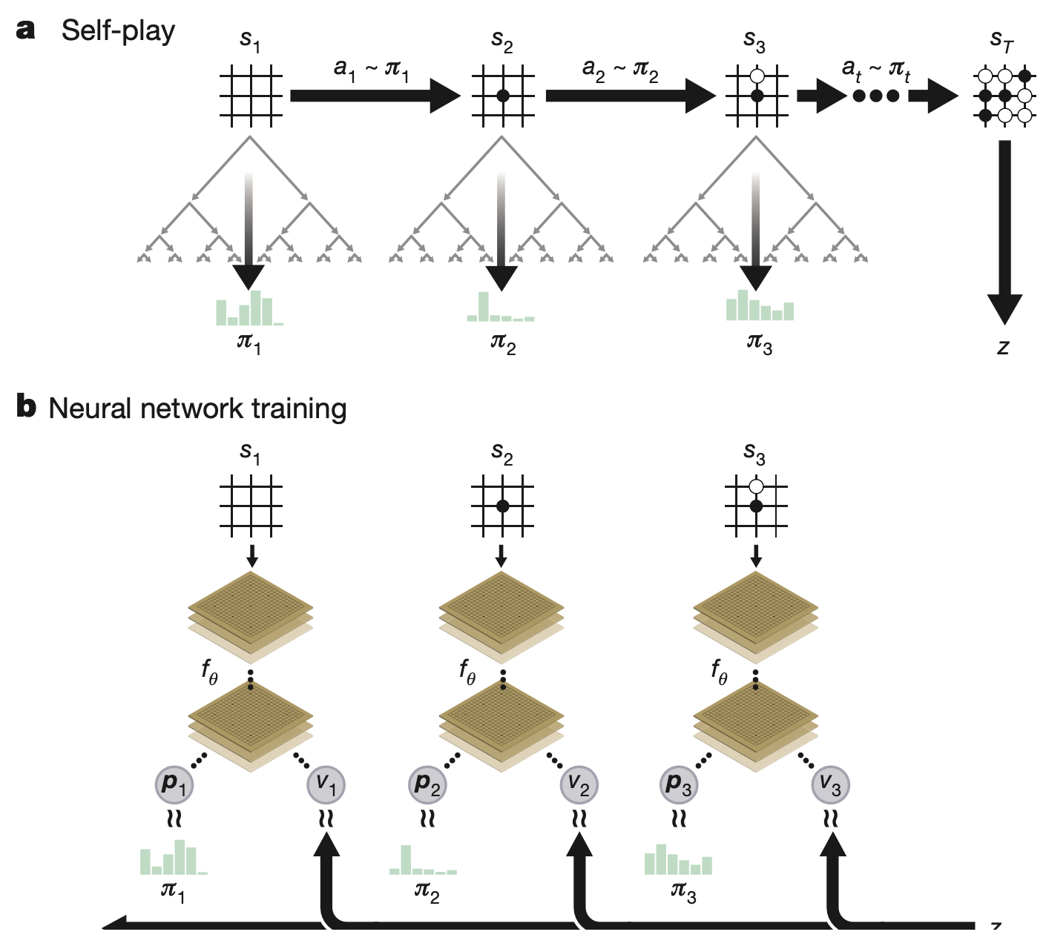
Whole Process
Self-play reinforcement learning in Alpha Zero

Slide 6
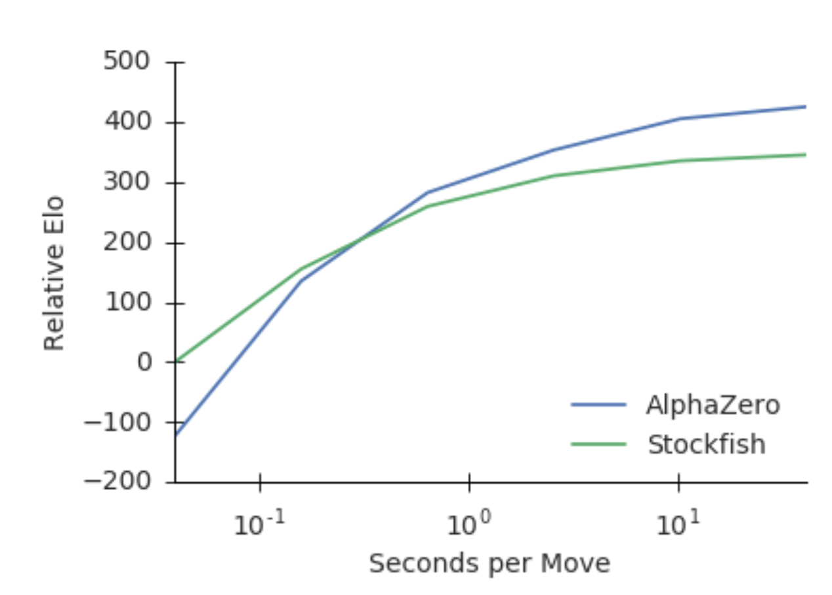
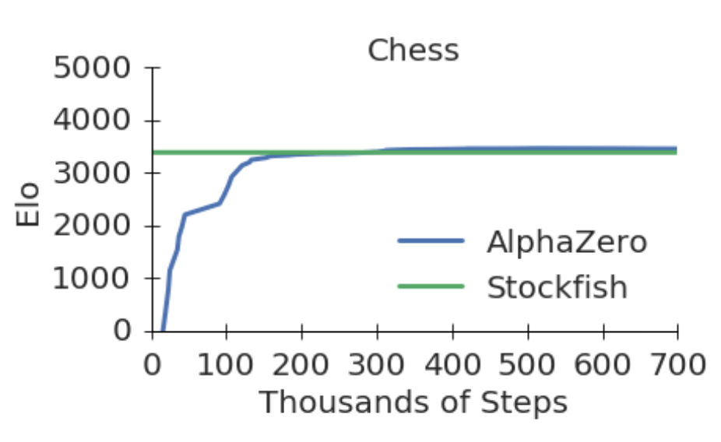
Problem we met
Training progress
Thinking time
Needs around 100k steps to achieve satisfactory results.
The search takes too much time during games.

Slide 7
Part 2: Search algorithm based on evaluating method
Goals we want the agent to reach:
Better evaluating methods
Faster searching rate
Smarter avoidance of danger
Next we will introduce the path we realize it!

Slide 8
Searching Strategy
MiniMax Algorithm, A simple idea
Make it simpler: NegaMax!
Advantage
Easy to modify and expand
Good compatibility for both sides

Slide 9
Evaluation Function
Type value
Position value
Conflict value
Number of attacks
Number of defended

Slide 10
Quiescent Search
Basic Idea: Search when the depth is used up.
If evaluation is good, return.
Add attacking actions and continue quiescent search
Advantage
Make full use of time limits
Not limited by depth

Slide 11
MVV/LVA Heuristic
Basic Tools:
Monte Carlo Tree Search
Neural Network

Slide 12
Make Search Faster
Key : Prune as soon as possible!
Sorting!

Slide 13
Make Search Faster
History heuristic: We believe the best action in history may be the best action in its current state
Make a history table.
Increases the weight of the best action proportional to the depth

Slide 14
Principal Variation Search
Basic Tools:
Monte Carlo Tree Search
Neural Network

Slide 15
Time Limited Search
Iterative Deepening!
Basic Idea: If there’s time left, deepen the search.
Advantage:
Avoid not knowing how deep to search.
Make full use of time

Slide 16
Recognize Repeated Board State
Simple way
Compare each position on the board
Time-consuming!
Zobrist key
Assign a hash value to each piece for each position
Perform the XOR operation to get the hash value
Update only requires the changed pieces on the board

Slide 17
Recognize Repeated Board State
If the board state is repeated:
Repeat a search.
If meet this repetitive, skip it.
Find a suboptimal solution

Slide 18
Part 3: Further More...
Sort with evaluating heuristic
Brother node heuristic
Opening book
Translation table

Slide 19
Sort with evaluation heuristic
Basic idea: expand node that matters first
Get the search tree pruned “quickly”
Trade-off between sorting cost and
expanding + pruning cost
Sometimes worse 😭 ( Add a translation table! )

Slide 20
Brother node heuristic
Also called “Killer Step”
An experiential heuristic
Basic idea: expand node that brothers have chosen first
Highly likely to get the search tree pruned earlier
Confirm the legality of actions

Slide 21
Opening book
Present situation: stubborn opening 😡
due to the quiescent evaluation method
Randomly choose a way to start from opening book
Not that amateur in the beginning state

Slide 22
Translation table
Record upperbound/lowerbound/exact value of nodes
Advantage:
Recognize repeated state
Accelerate searching process when using “sort with evaluation” heuristic
Easy start: record Zobrist Key & HASH_SIZE as index
Replace strategy?

Slide 23
Thanks for watching!

